Slide 1
Word Ladders
(part 1)
Transform and Conquer: Representation Change

Slide 2
Word Ladders
The word ladder game gives players two words of the same length, such as:
PIT
CAT
The goal of Word Ladders is to make a chain of valid words by changing exactly 1 letter at a time. Players should connect the two words with five or fewer rungs..
Can you make a word ladder chain for PIT and CAT?
Notes:
Optional Do Now: have students do a Word Ladder quiz
https://www.sporcle.com/games/Doctor_Arzt/reading-rainbow-word-ladder

Slide 3
Word Ladders: One Solution
PIT
PUT
HUT
HAT CAT
This Word Ladder solution has 3 rungs because there are three words connecting PIT to CAT.

Slide 4
Word Ladders: The Best Solution
PIT
PAT CAT
This solution has 1 rung because there is one word connecting PIT to CAT.
This is the shortest possible ladder connecting PIT to CAT.
Notes:
What makes this solution better than the solution on the previous slide?
Fewer words…

Slide 5
What data model and algorithm would you use to tell a computer how to construct Word Ladders for 3, 4, or 5 letter words? Why?

Slide 6
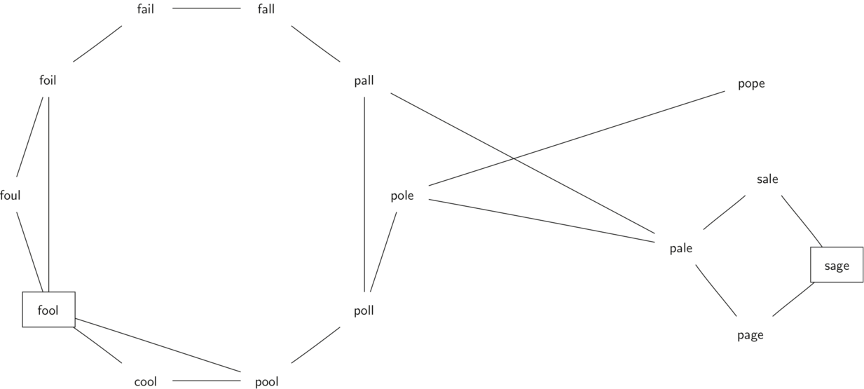
Word connections as a graph
Notes:
One way would be to use a graph to define how/whether words are connected to each other.
This would make it relatively straightforward (from a human perspective) to find a path between two words, and also to determine a path between connected words.

Slide 7
What are some advantages of modeling this problem as a graph?
Notes:
Characteristics that point to a Graph:
Words can connect to many other word
A different number of connections per word
Unordered
Once the word ladder problem is modeled as a graph, the solution becomes a matter of finding the shortest path from a start word to a target word
There already exist well-understood solutions for finding paths through a graph

Slide 8
Rephrase the shortest word ladder problem as a graph problem.
Notes:
Characteristics that point to a Graph:
Words can connect to many other word
A different number of connections per word
Unordered
Once the word ladder problem is modeled as a graph, the solution becomes a matter of finding the shortest path from a start word to a target word
There already exist well-understood solutions for finding paths through a graph

Slide 9
Graph Vocab
Path
A path is a sequence of vertices that you can go through by traveling through only the edges.
Path Length
The length of a path is the number of edges in the path.
Distance
The distance from vertex A to vertex B in a graph is the length of the shortest path from vertex A to vertex B.
A
E
A
E
A
E
D
D
D
B
B
B
C
C
C

Slide 10
Shortest Path Problem
Given a graph G, a starting node S and a target node T, we would like to find the shortest path from S to T.
If there is more than one shortest path, we would like to find any one of them.

Slide 11
Shortest Path Problem
Given a graph G, a starting node S and a target node T, we would like to find the shortest path from S to T.
If there is more than one shortest path, we would like to find any one of them.
One algorithm which solves the shortest path problem is Breadth-First Search (BFS).
Notes:
Note: BFS doesn’t just solve the single-source-single-target shortest path problem.

Slide 12
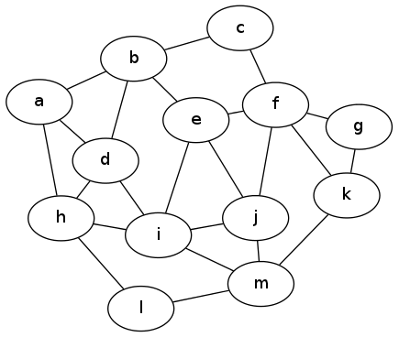
BFS: Idea
Let’s find all nodes which have distance 1 from S. S=____

Slide 13
BFS: Idea
Let’s find all nodes which have distance 1 from S. S=____
Which vertices have distance 2 from S?

Slide 14
BFS: Idea
Let’s find all nodes which have distance 1 from S. S=____
Which vertices have distance 2 from S?
How does this help us find the distance from S to T?

Slide 15
BFS: Idea
Let’s find all nodes which have distance 1 from S. S=____
Which vertices have distance 2 from S?
How does this help us find the distance from S to T?
How can we modify this process to find a shortest path from S to T?
Notes:
Finding shortest path: parent pointers

Slide 16
Breadth-first Search (BFS)
def bfs(graph, root):
visited_nodes = set()
visited_nodes.add(root)
neighbors_queue = [root]
while neighbors_queue:
vertex = neighbors_queue.pop(0)
print(f"{str(vertex)} ")
for neighbour in graph[vertex]:
if neighbour not in visited_nodes:
neighbors_queue.append(neighbour)
visited_nodes.add(neighbour)
Breadth-first search is an algorithm that searches through the nodes in a graph in a systematic way:
Pick a node to visit first (called “root”)
Mark the node as visited
Add the node to a queue of nodes which need its neighbors to be visited
While there still nodes in the queue which need neighbors to be visited:
Take the first node out of the queue
Visit all of the neighbors from that node
If the neighbor hasn’t been visited
Mark the neighbor as visited
Add the neighbor to the queue
Demo code: bfs_demo.py

Slide 17
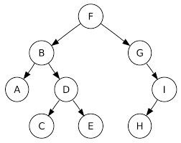
Use VSCode breakpoints to step through the BFS algorithm.
In particular, pay attention to the contents of :
visited_nodes
neighbors_queue
F→B→G→A→D→I→C→E→H
What happens when you change the root node?
binary_tree_graph ={
'A':{'B'},
'B':{'F','A','D'},
'C':{'D'},
'D':{'B','C','E'},
'E':{'D'},
'F':{'B', 'G'},
'G':{'F','I'},
'H':{'I'},
'I':{'G', 'H'}
}
bfs_demo.py - BFS on a binary tree (a graph that satisfies certain properties)

Slide 18
Discuss: BFS
def bfs(graph, root):
visited_nodes = set()
visited_nodes.add(root)
neighbors_queue = [root]
while neighbors_queue:
vertex = neighbors_queue.pop(0)
print(f"{str(vertex)} ")
for neighbour in graph[vertex]:
if neighbour not in visited_nodes:
neighbors_queue.append(neighbour)
visited_nodes.add(neighbour)
What is the purpose of this BFS algorithm?
What is the role of visited_nodes?
What is neighbors_queue used for?
Why is visited_nodes a set, while neighbors_queue is a list?
Which type of variable should we use to store the path from a root node to a destination node? Why?
How would we modify this BFS function to remember the path taken from the root node to a destination node?

Slide 19
What’s the shortest path between FOOL and SAGE?
Word connections as a graph
Notes:
One way would be to use a graph to define how/whether words are connected to each other.
This would make it relatively straightforward (from a human perspective) to find a path between two words, and also to determine the shortest path.

Slide 20
BFS: Finding Paths
def bfs_path(graph, root, target):
path_queue = [[start]]
while path_queue:
old_path = path_queue.pop(0)
last_node = old_path[-1]
for neighbour in graph[last_node]:
if neighbour not in old_path:
new_path = old_path.copy()
new_path.append(neighbour)
path_queue.append(new_path)
if neighbour == target:
return tuple(new_path)
return tuple()
The word ladder problem is an analog for finding the shortest path through a graph.
Keeping track of paths versus individual nodes requires keeping a list of lists in the path_queue variable, where each element in the queue is a different partial pathway through the graph.
Removing the first potential path with path_queue.pop(0) will ensure that we build paths in a certain order: closest words first
Lists of partial paths keep track of which nodes have already been visited, so there’s no need for an extra visited variable for each potential path.
Once BFS has encountered the target node, the algorithm returns the path which connects the start node with the target node.

Slide 21
BFS: Finding Paths
def bfs_path(graph, root, target):
path_queue = [[start]]
while path_queue: #ie. len(path_queue) >= 1
#take the first path from the path_queue
old_path = path_queue.pop(0)
#start from the last node in that path
last_node = old_path[-1]
#consider each neighbor of the last node
#in the path being considered
for neighbour in graph[last_node]:
#if the neighbor hasn't been considered yet
if neighbour not in old_path:
#add a new path to the list of paths to consider
new_path = old_path.copy()
new_path.append(neighbour)
path_queue.append(new_path)
#first time you find the target
#gives you "a" shortest path
if neighbour == target:
return tuple(new_path)
return tuple() #no path exists
The word ladder problem is an analog for finding the shortest path through a graph.
Keeping track of paths versus individual nodes requires keeping a list of lists in the path_queue variable, where each element in the queue is a different partial pathway through the graph.
Removing the first potential path with path_queue.pop(0) will ensure that we build paths in a certain order: closest words first
Lists of partial paths keep track of which nodes have already been visited, so there’s no need for an extra visited variable for each potential path.
Once BFS has encountered the target node, the algorithm returns the path which connects the start node with the target node.

Slide 22
Use VSCode breakpoints to step through the BFS_path algorithm.
In particular, pay attention to the contents of :
path_queue
old_path
last_node
new_path
binary_tree_graph ={
'A':{'B'},
'B':{'F','A','D'},
'C':{'D'},
'D':{'B','C','E'},
'E':{'D'},
'F':{'B', 'G'},
'G':{'F','I'},
'H':{'I'},
'I':{'G', 'H'}
}
bfs_demo.py - BFS on a binary tree (a graph that satisfies certain properties)

Slide 23
Exercises:
Use the starter code provided in graph.py to implement a Graph helper class:
We’ll use this generic Graph class to help us solve Word Ladders for our next activity.
Graph
adj_list: dict[str, set[str]] vertices: set[str] edges: set[tuple[str]]]
__init__(adj_list: dict[str, set[str]]) is_vertex(str): bool get_neighbors(str): set[str] is_valid_path(list[str]): bool get_shortest_bfs_path(str, str): tuple[str] get_shortest_bfs_path_length(str, str): int get_all_shortest_bfs_paths(str, str): set[tuple[str]]

